Slide 1
Interim Urgency Ordinance
North Pyrite Master Plan Area
City Council, January 15, 2026

Slide 2
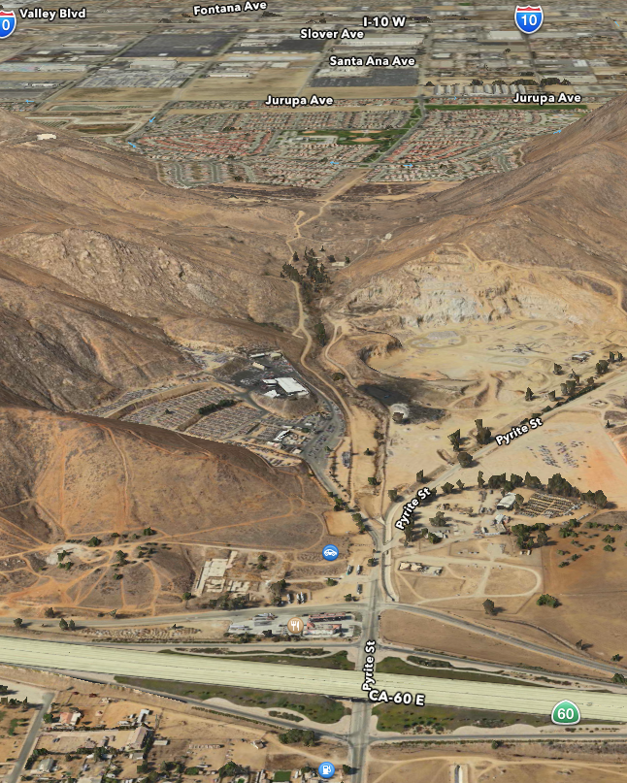
Interim Urgency Ordinance
North Pyrite Master Plan Area
Temporary moratorium pausing acceptance and processing of land use applications
Adopted pursuant to Government Code Section 65858
Protects public health and safety pending environmental studies and investigations
Addresses potential impacts from Stringfellow Superfund Site

Slide 3
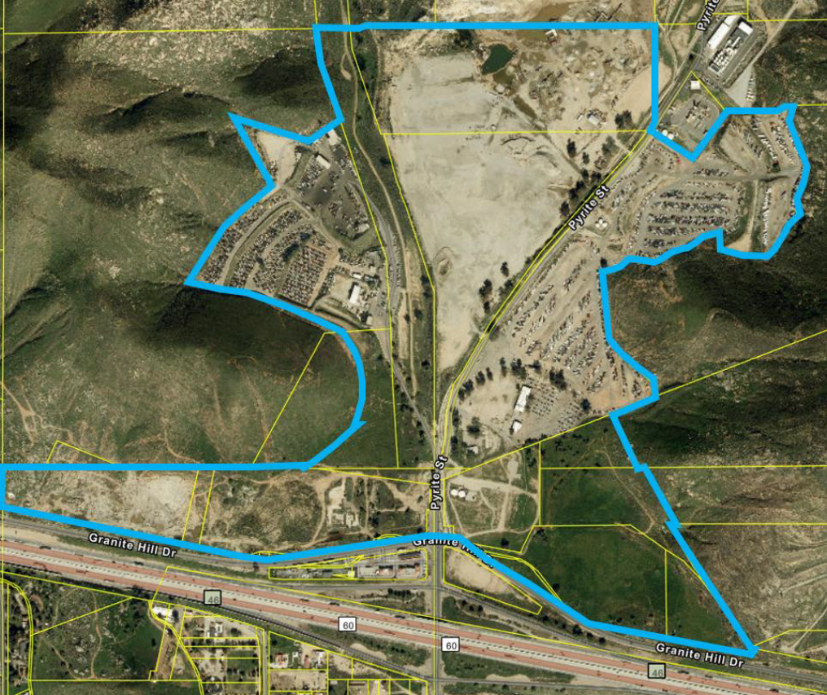
Background
North Pyrite Master Plan (NPMP) area is approximately 215 acres
Located downstream of Stringfellow Superfund Site
Site accepted approximately 35 million gallons of hazardous waste between 1956 and 1972
Cleanup and monitoring by DTSC with EPA oversight
Long-term environmental conditions in lower Pyrite Canyon remain uncertain
Stringfellow
Site
N

Slide 4
DESCRIPTION OF ISSUES
Public health and safety risk due to unknown soil, groundwater, and vapor intrusion conditions
Incomplete environmental data for area-wide development suitability
EPA has not issued a final Record of Decision (ROD)
Environmental studies to date are parcel-specific, not comprehensive
City Council and community requested verification of safety prior to new development

Slide 5
SCOPE OF THE MORATORIUM
Prohibits acceptance, processing, or approval of new development applications
Applies to discretionary and ministerial permits
Prohibits expansion of existing uses within the NPMP Area
Allows maintenance of legal existing uses and public safety infrastructure
Exempts EPA and DTSC remediation and monitoring activities

Slide 6
DURATION, ENVIRONMENTAL REVIEW,
AND FISCAL IMPACT
Initial moratorium duration of 45 days; may be extended up to two years (first extension: 10 month and 15 days and second extension: one year)
Ordinance is CEQA-exempt under Guidelines §15061(b)(3)
Moratorium prevents potential environmental impacts during study period
City costs limited to Advance Planning budget; future costs addressed through reimbursement

Slide 7
Moratorium Process
January 15, 2026 City Council considers moratorium
If moratorium is approved:
  On February 5, 2025, City Council must issue a report describing measures taken to alleviate the conditions that led to moratorium
  On February 19, 2026, Council will consider adoption of ordinance extending moratorium for additional 10 months and 15 days (expiring January 14, 2027)

Slide 8
RECOMMENDATION
Adopt an Interim Urgency Ordinance imposing a temporary moratorium on receiving, processing and approval of new development within the NPMP area pursuant to Government Code Section 65858 until environmental studies are complete
Determine the action is exempt from CEQA pursuant to §15061(b)(3)
N

Slide 9
Interim Urgency Ordinance
North Pyrite Master Plan Area
City Council, January 15, 2026

